Slide 1
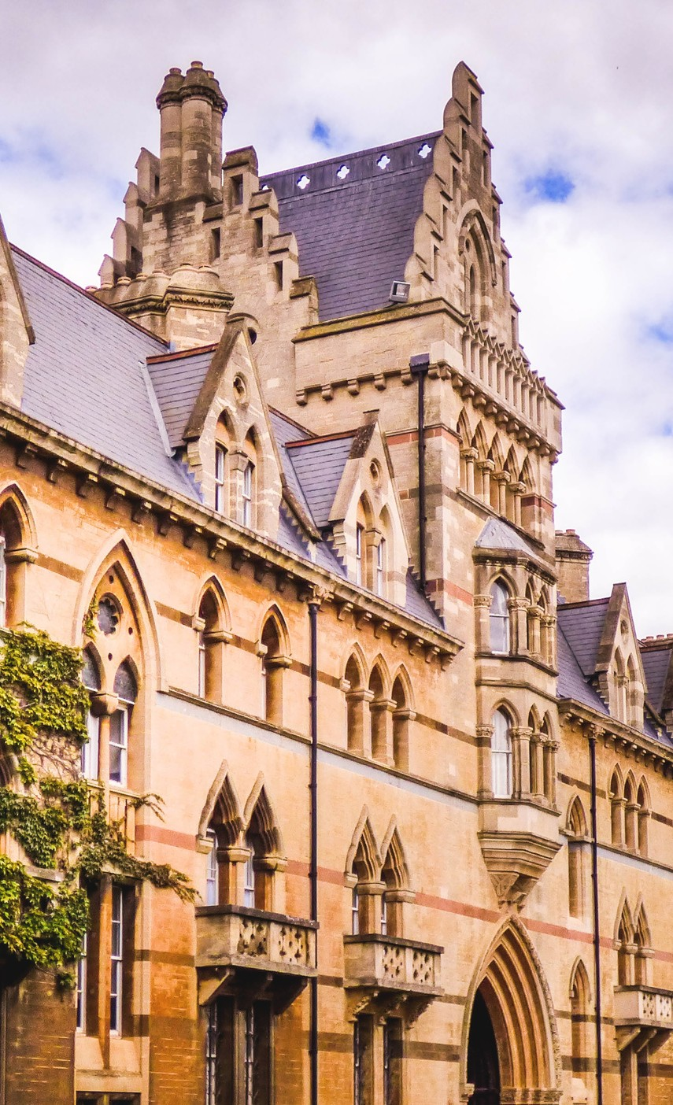
English language
Prešov
P R E S E N T E D B Y A D A M S T R E L E C

Slide 2
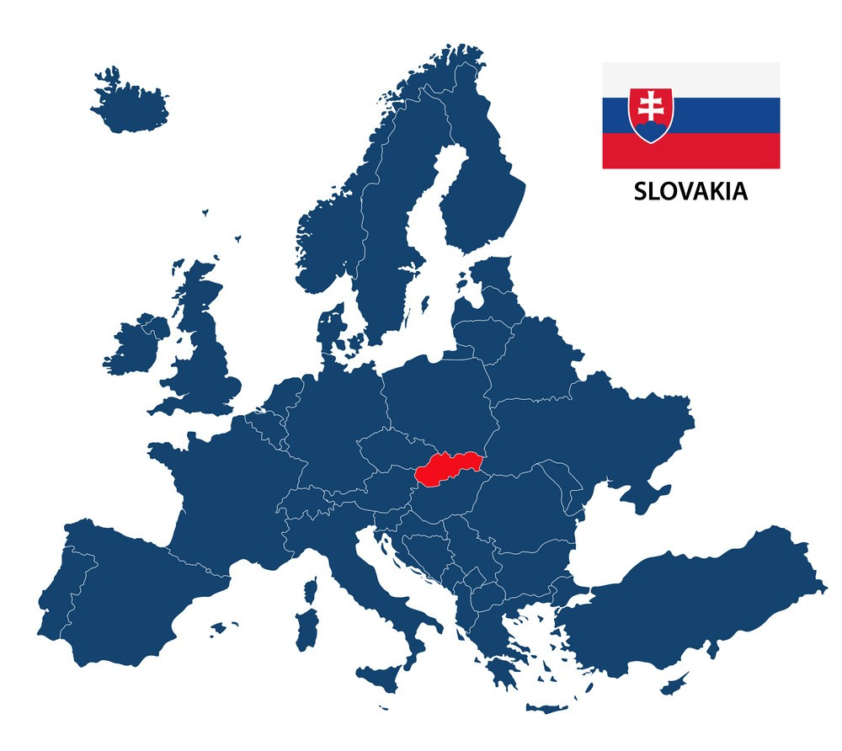
Slovakia
Heart of the Europe
5.4 milion residents 1993- Independace of
Slovak republic
Part of EU and NATO

Slide 3
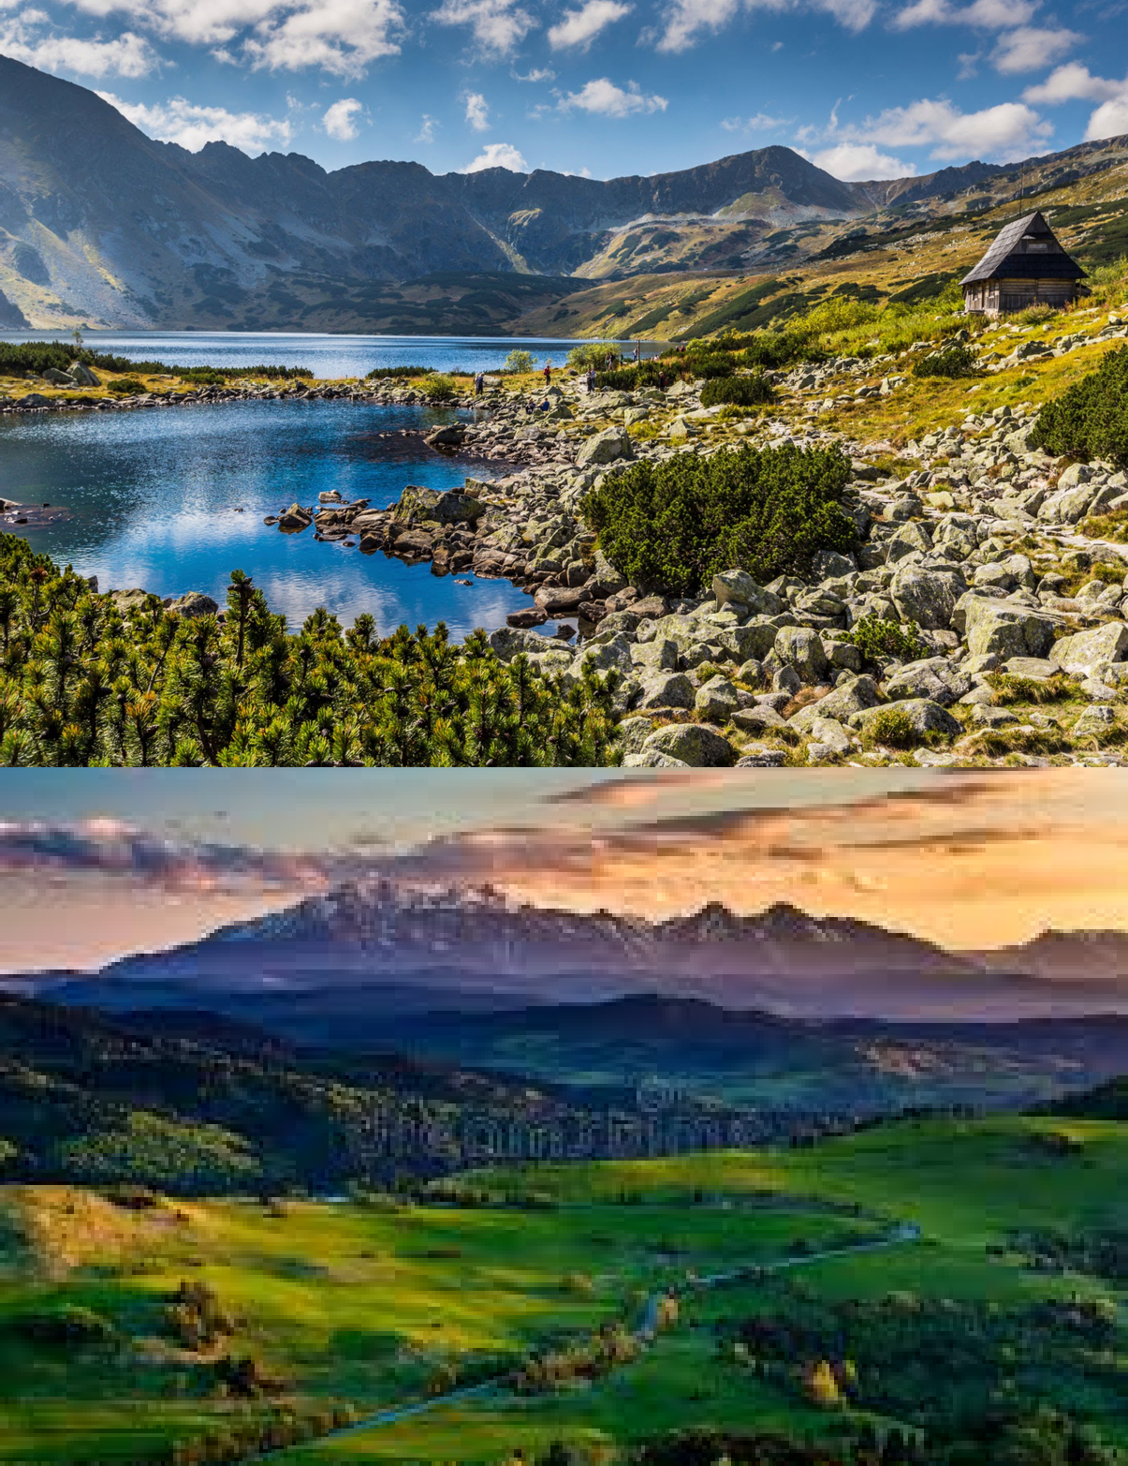
High Tatras
Symbol of Slovakia
Highest mountains in Slovakia Highest Peak - Gerlachovksý štít (2 655 above sea level)
Reservation in the UNESCO program Many endemics
Great place for tourism and relaxation

Slide 4
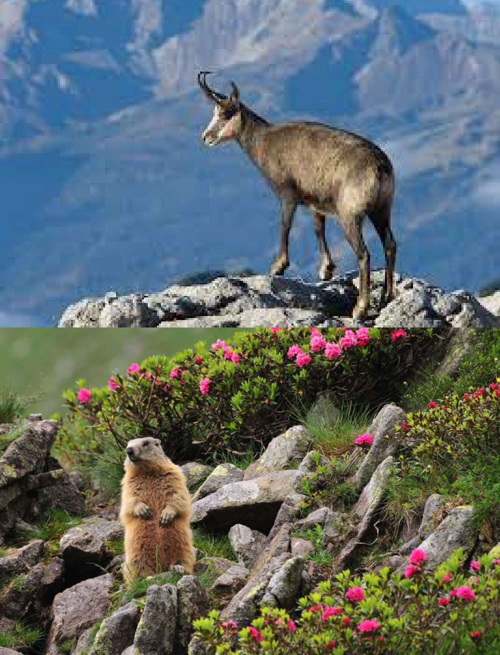
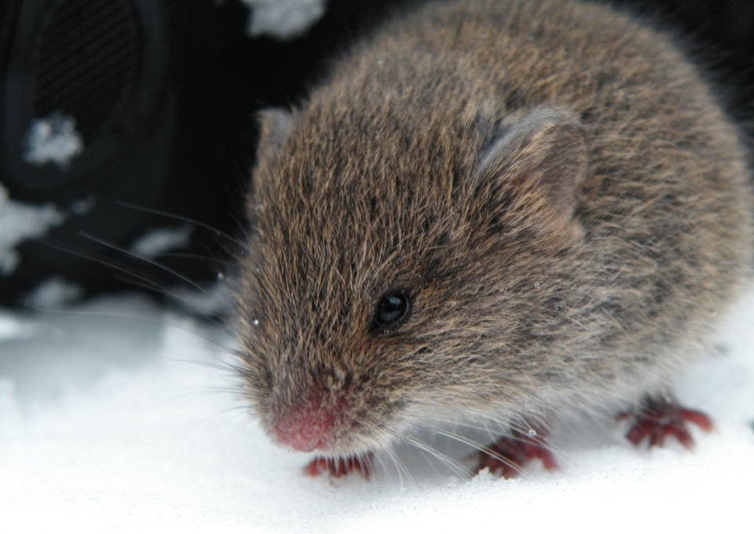
Endemics in Slovakia
What is endemic
Endemic is an animal or plant, that lives and grows only in certain areas.

Slide 5
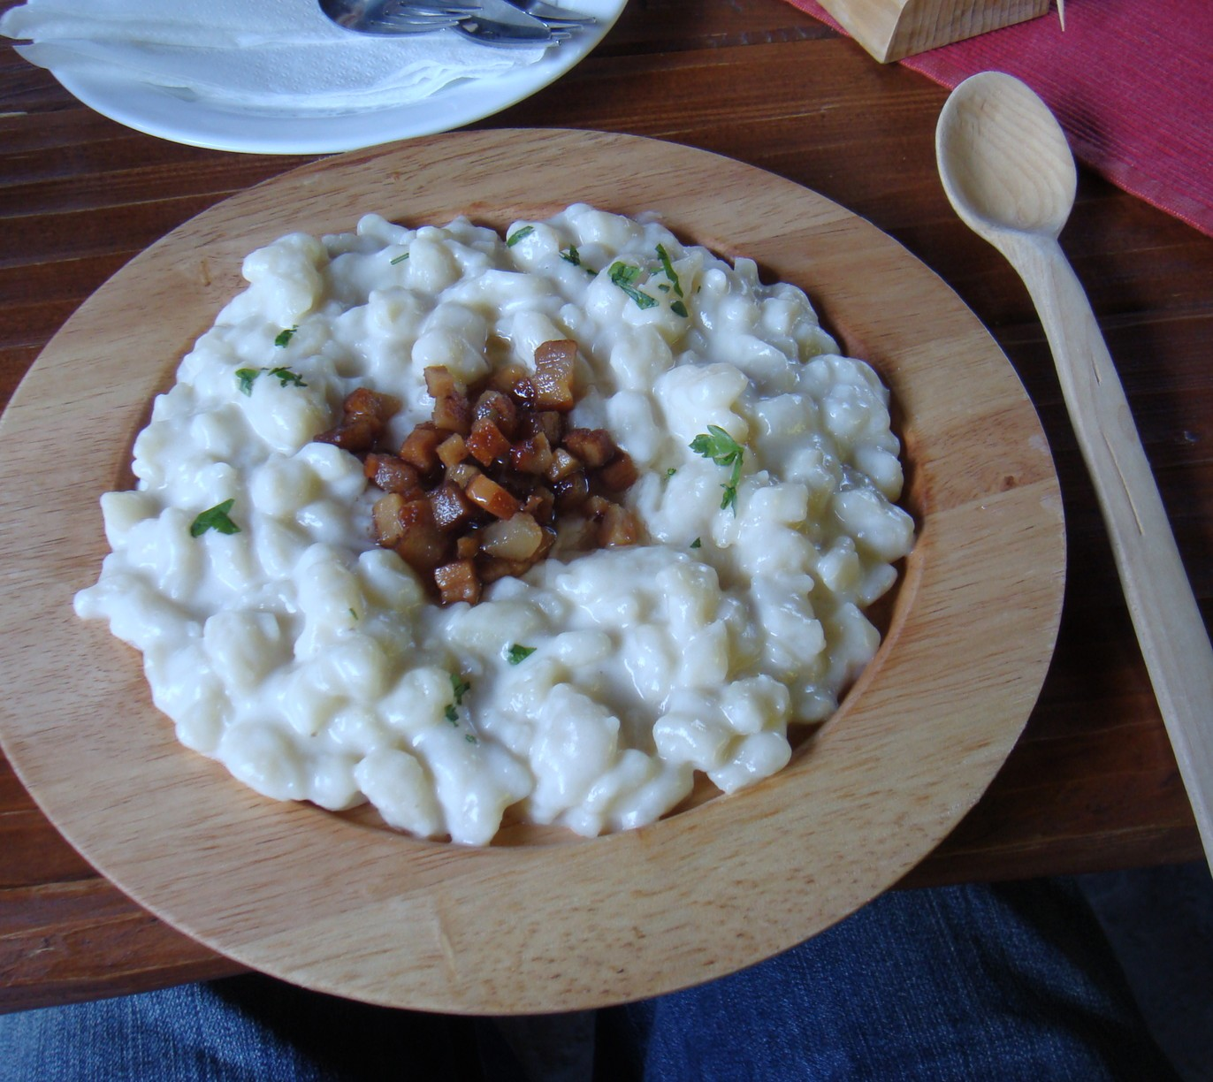
Slovak cuisine
Bryndzové halušky

Slide 6
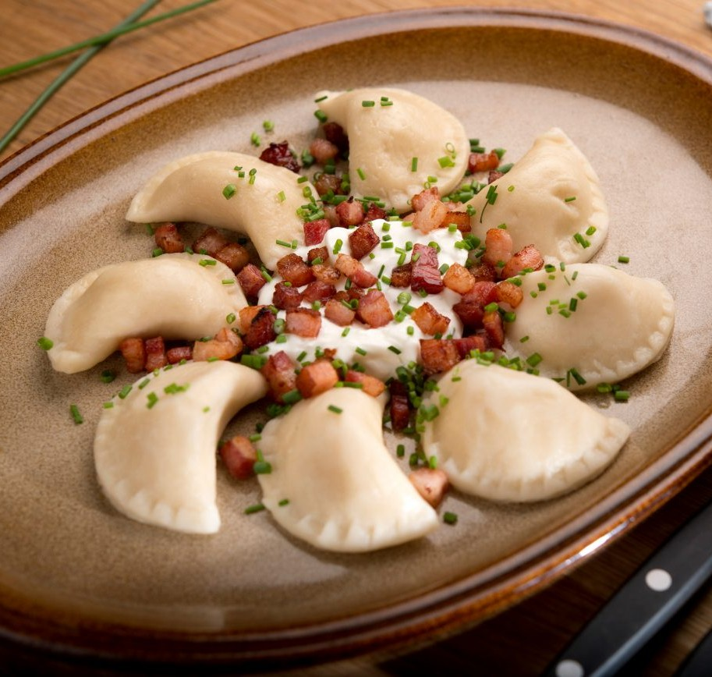
Slovak cuisine
Pirohy

Slide 7
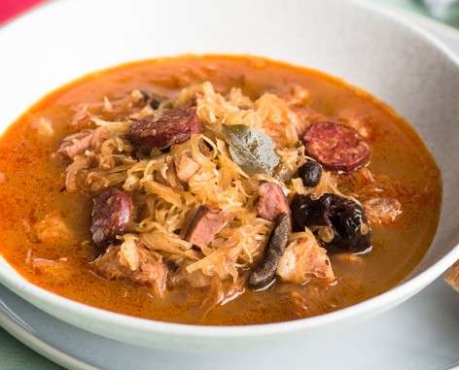
Slovak cuisine
Kapustnica

Slide 8
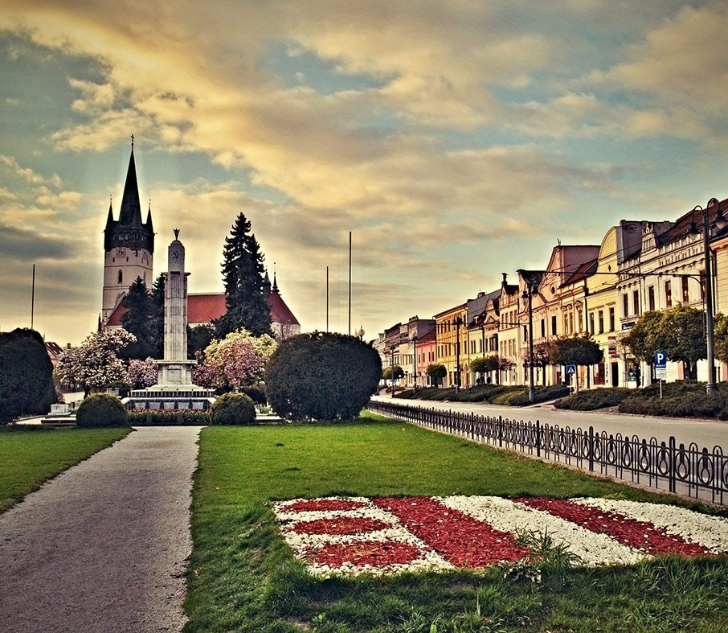
Prešov
90 000 residents
established: 9th century 3rd largest city
Oldest football club in SVK

Slide 9
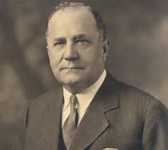
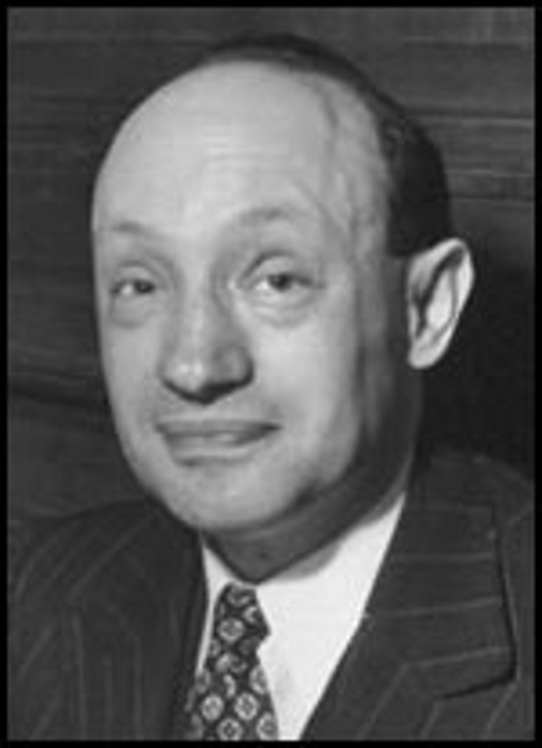
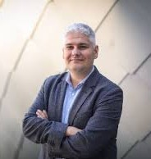
FAMOUS PREŠOV RESIDENTS
Michal Bosák
American banker
Ján Adam Reyman
Doctor
Pavol Čekan
Scientist
2 0 2 0 | H A L L O F F A M E

Slide 10
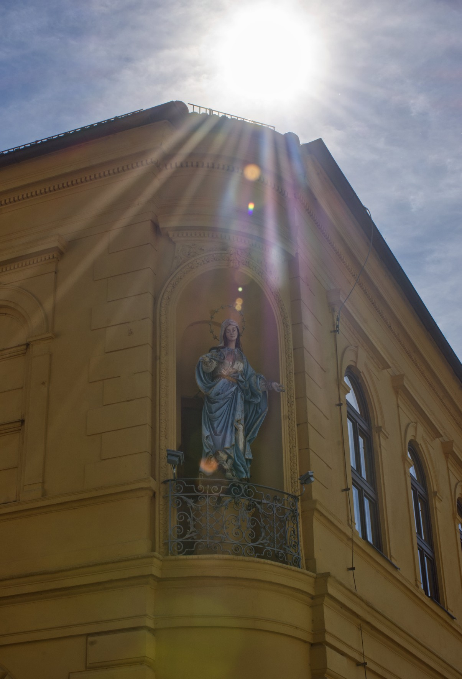
Department of history
Architecture
and History
P R E S E N T E D B Y A D A M S T R E L E C
@petinoh

Slide 11
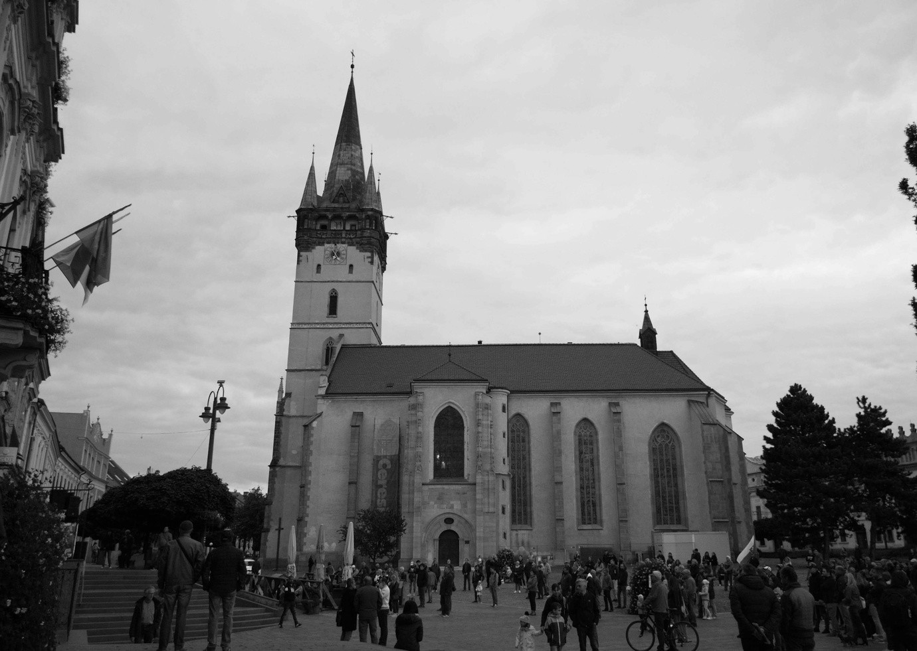
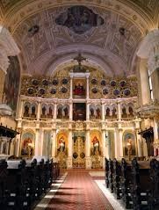
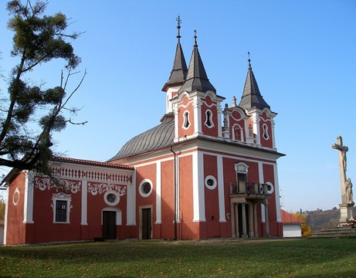
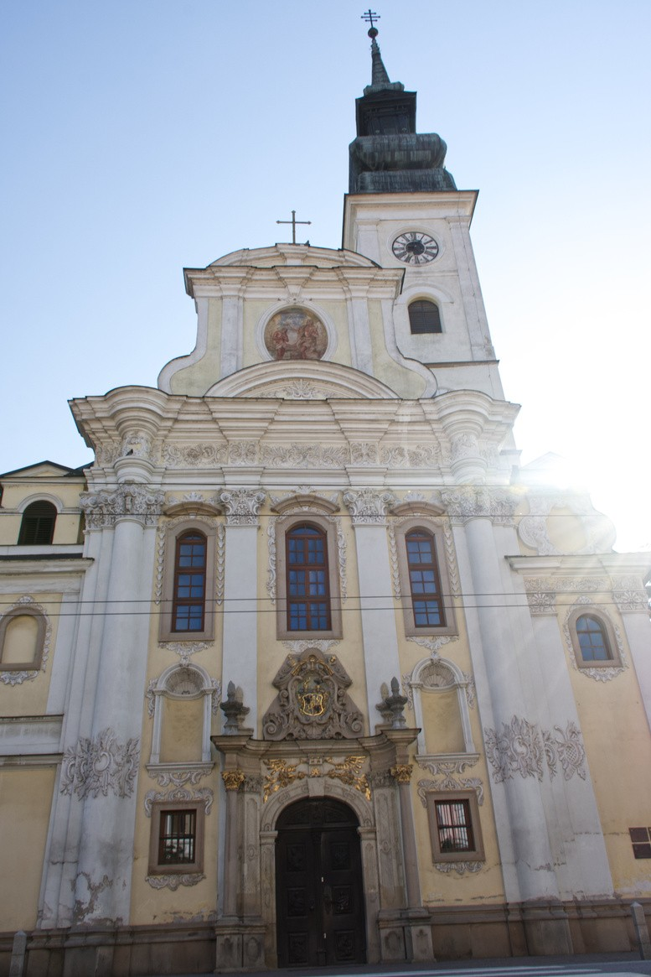
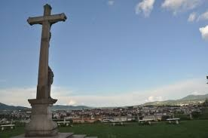
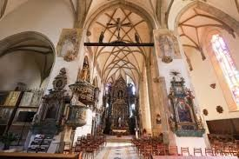
@petinoh
Church of John the Baptist
Prešov Calvary
Concathedral of St. Nicholas
@petinoh

Slide 12
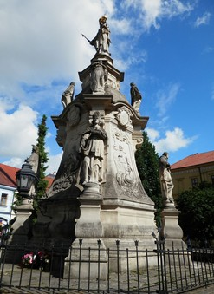
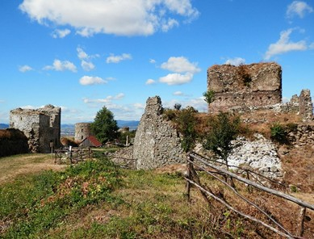
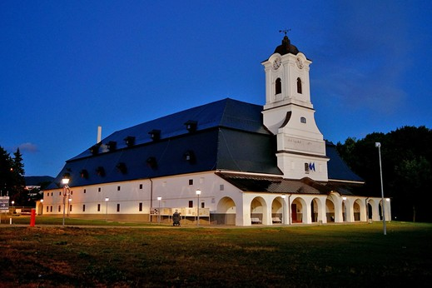
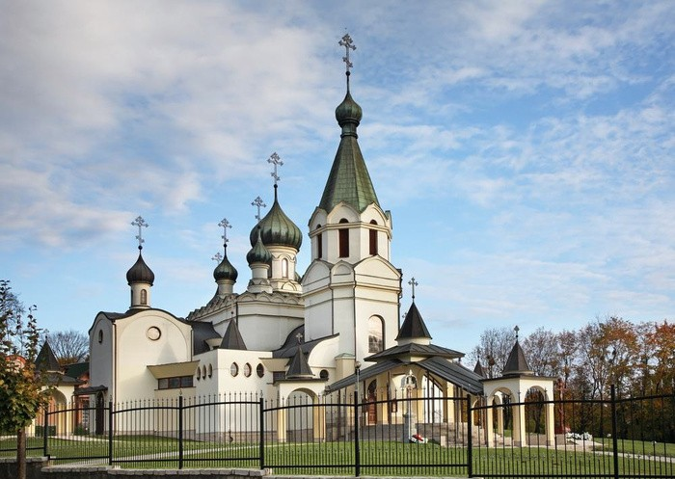
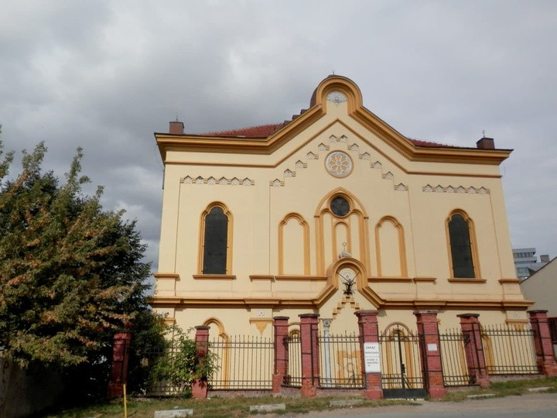
Things to see in Prešov

Slide 13
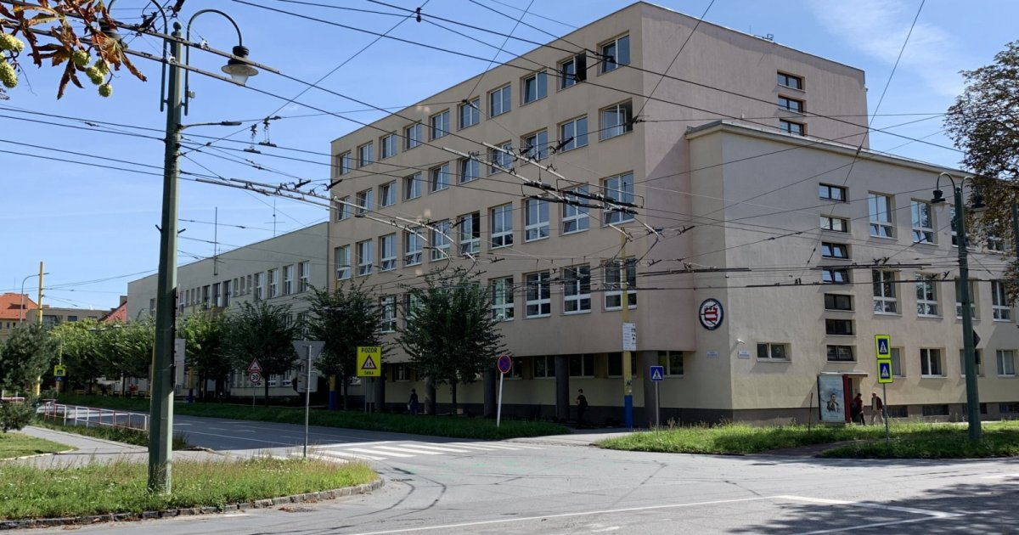
SPŠE Prešov
Established
1.9.1952
Amount of student
700

