Slide 1
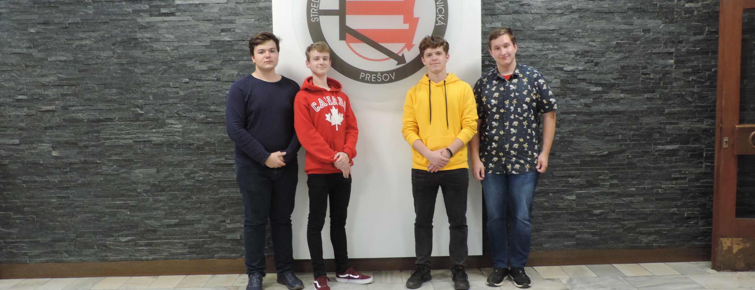
Oliver Sabol
Filip Ondrej
Adam Strelec
Patrik Sašina
Video / Cameraman
Video / Director
Presentation / Script
Script / Animation
Michael Kolesár
Presentation / Dabing

Slide 2
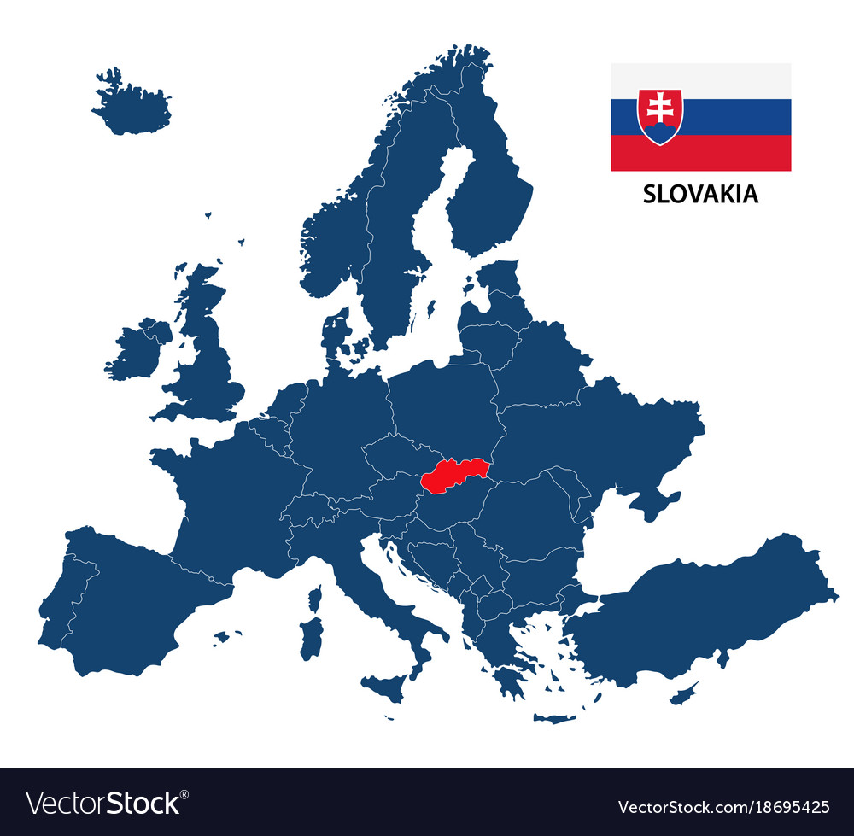
Slovakia
Heart of the Europe
5.4 milion residents
1993- Independace of Slovak republic
Part of EU and NATO

Slide 3
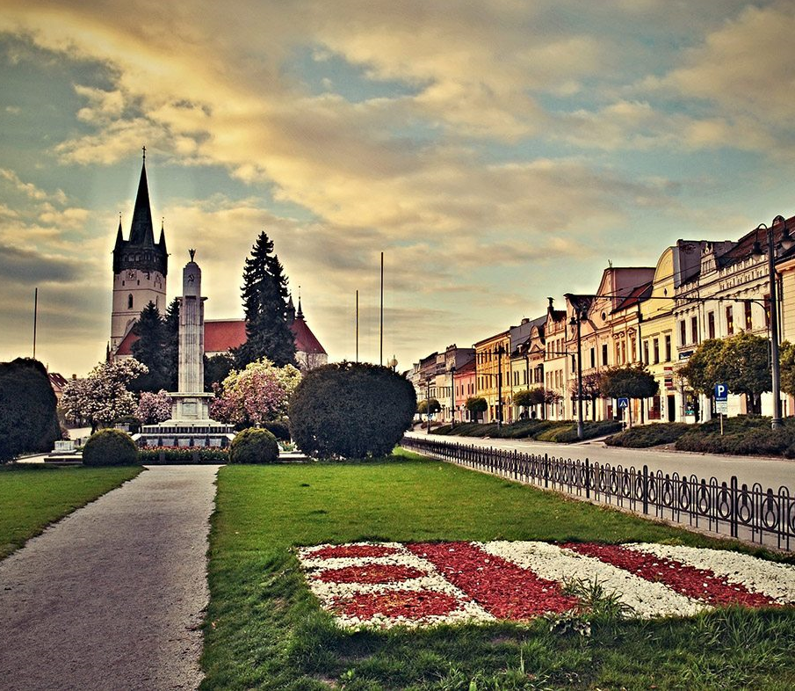
Prešov
90 000 residents
established: 9th century
3rd largest city
Oldest football club in SVK
2020 | DEPARTMENT OF HISTORY

Slide 4
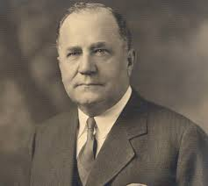
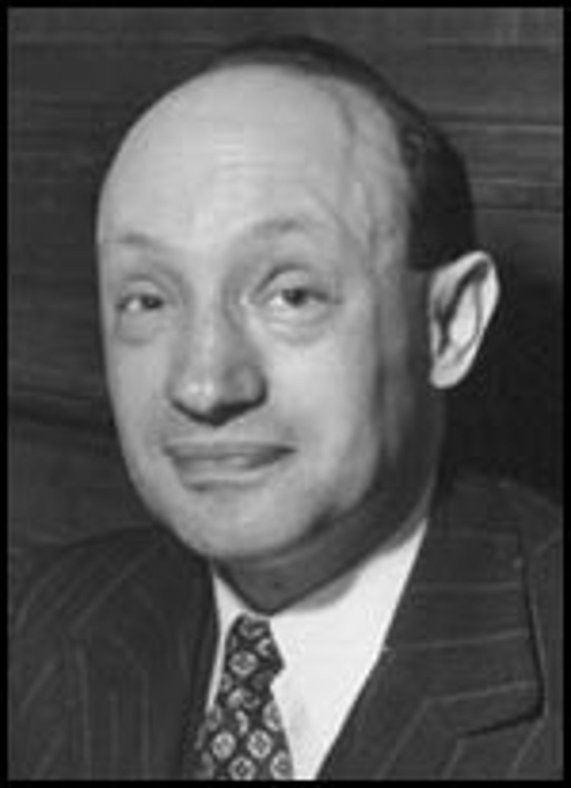
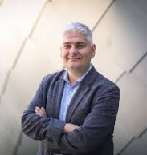
FAMOUS PREŠOV RESIDENTS
Michal Bosák
Ján Adam Reyman
Pavol Čekan
American banker
Doctor
Scientist
2020 | HALL OF FAME

Slide 5
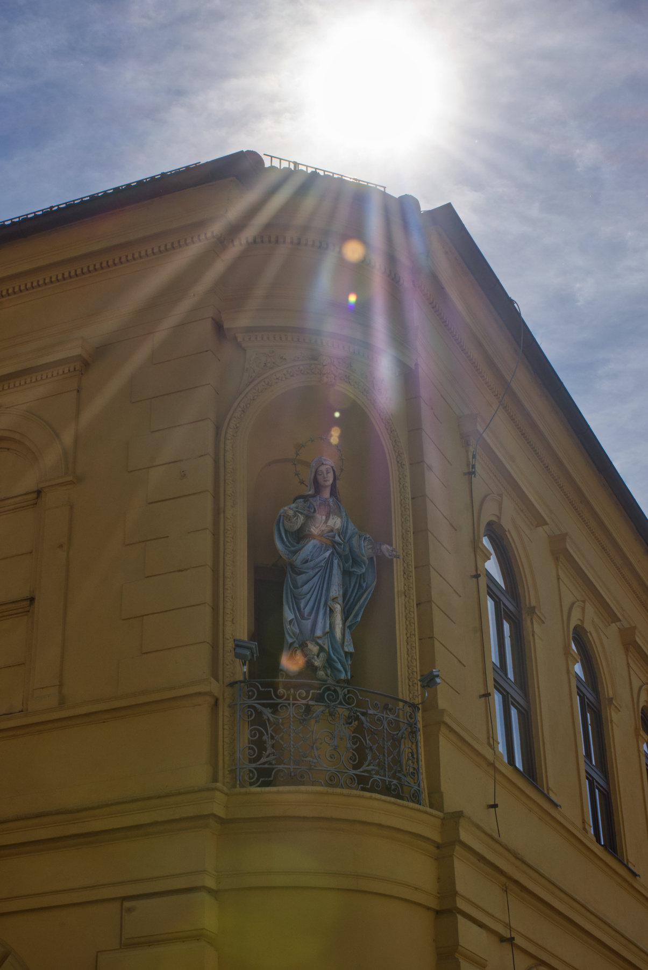
Department of history
Architecture
and
History
PRESENTED BY ADAM STRELEC
@petinoh

Slide 6
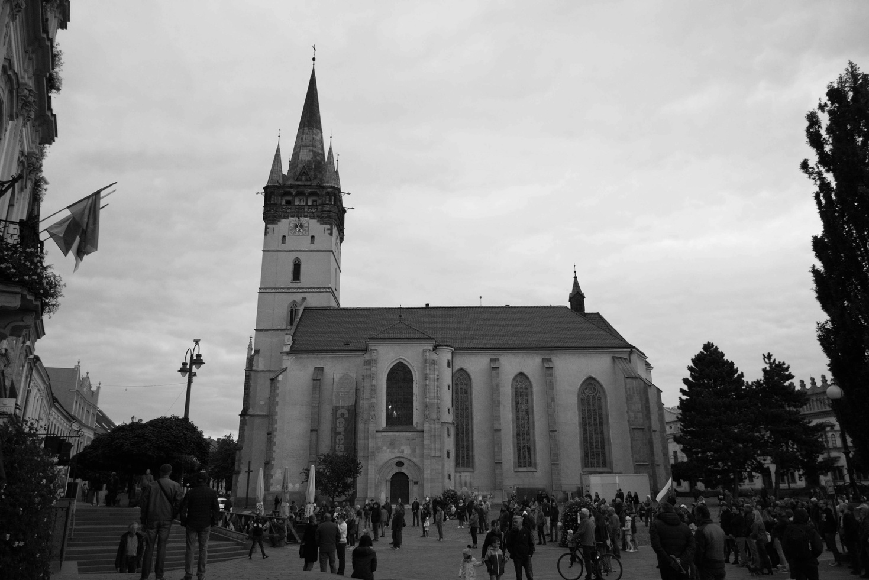
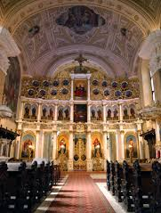
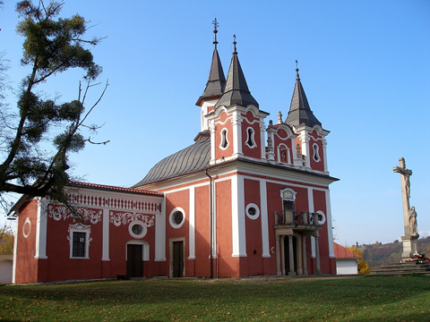
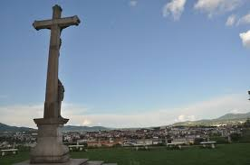
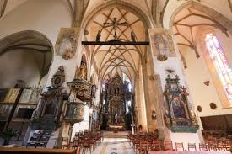
@petinoh
Church of John the Baptist
Prešov Calvary
Concathedral of St. Nicholas
@petinoh

Slide 7
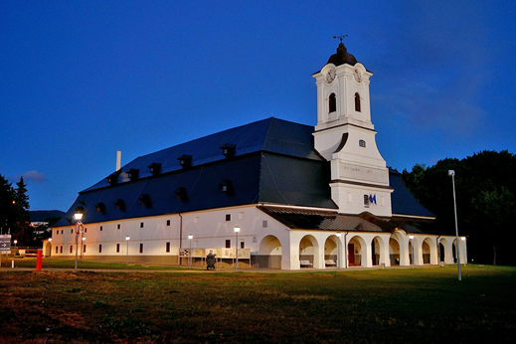
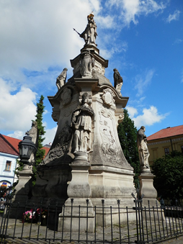
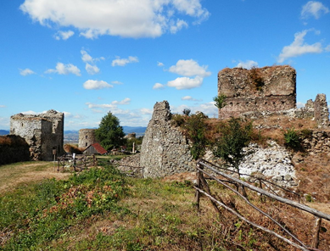
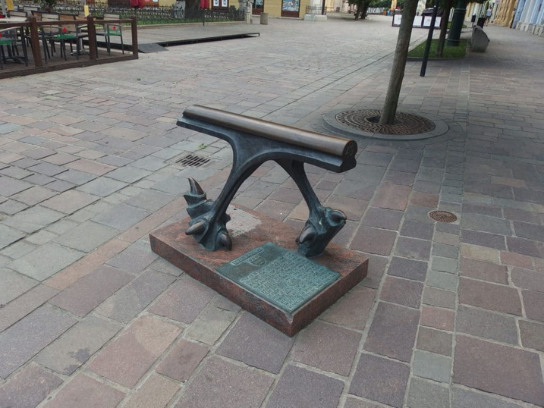
Things to see in Prešov
Places to visit

Slide 8
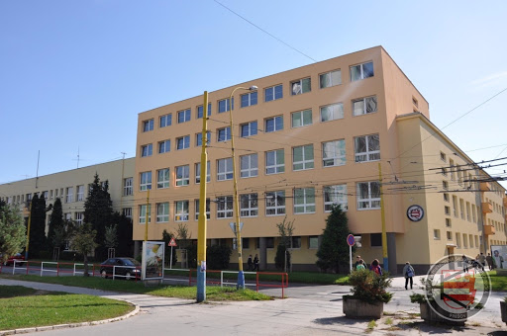
Secondary technical school of electrical engineering in Prešov
SPŠE

Slide 9
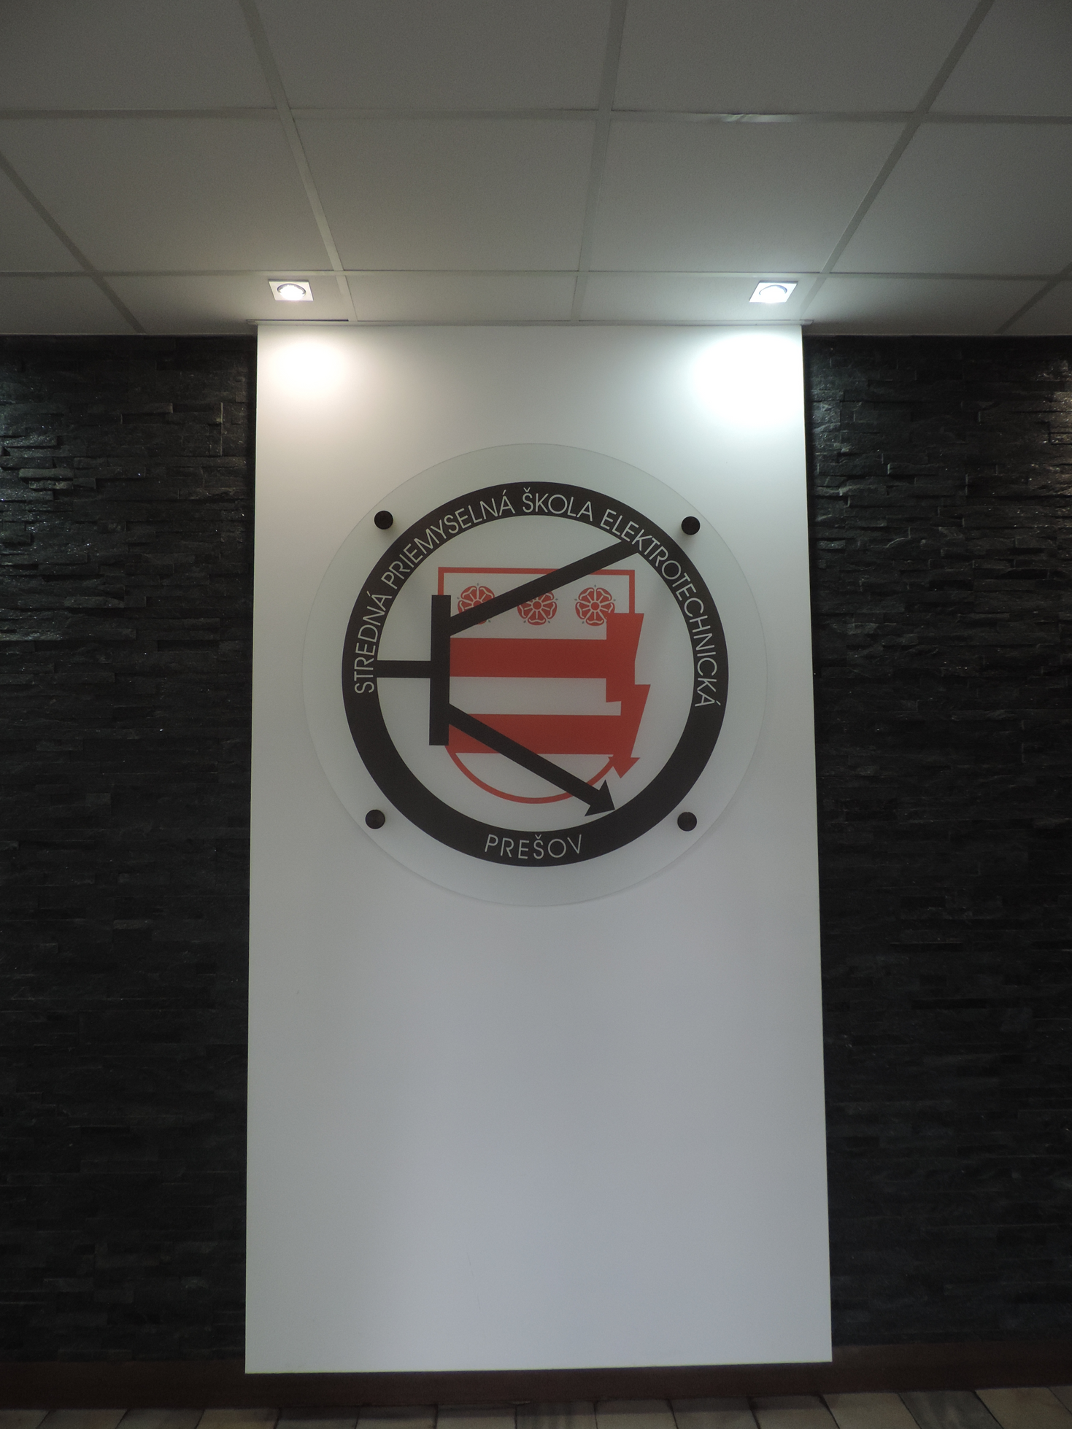
Established
1. September 1952
Study sections
electrical engineering
IT management
information and network technologies

Slide 10
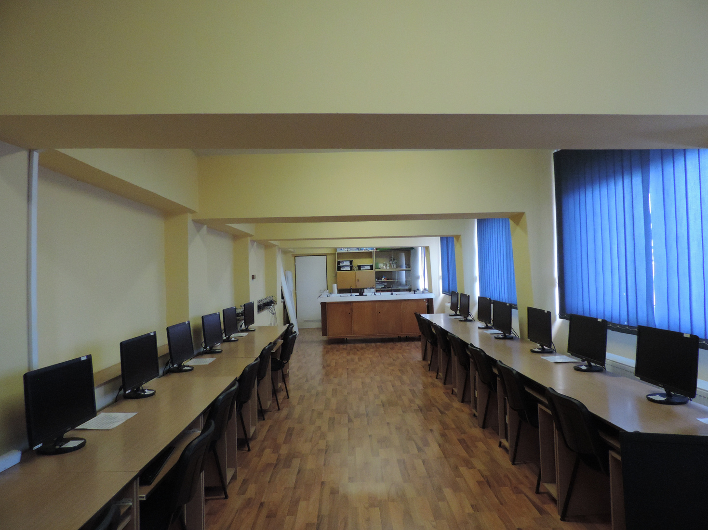
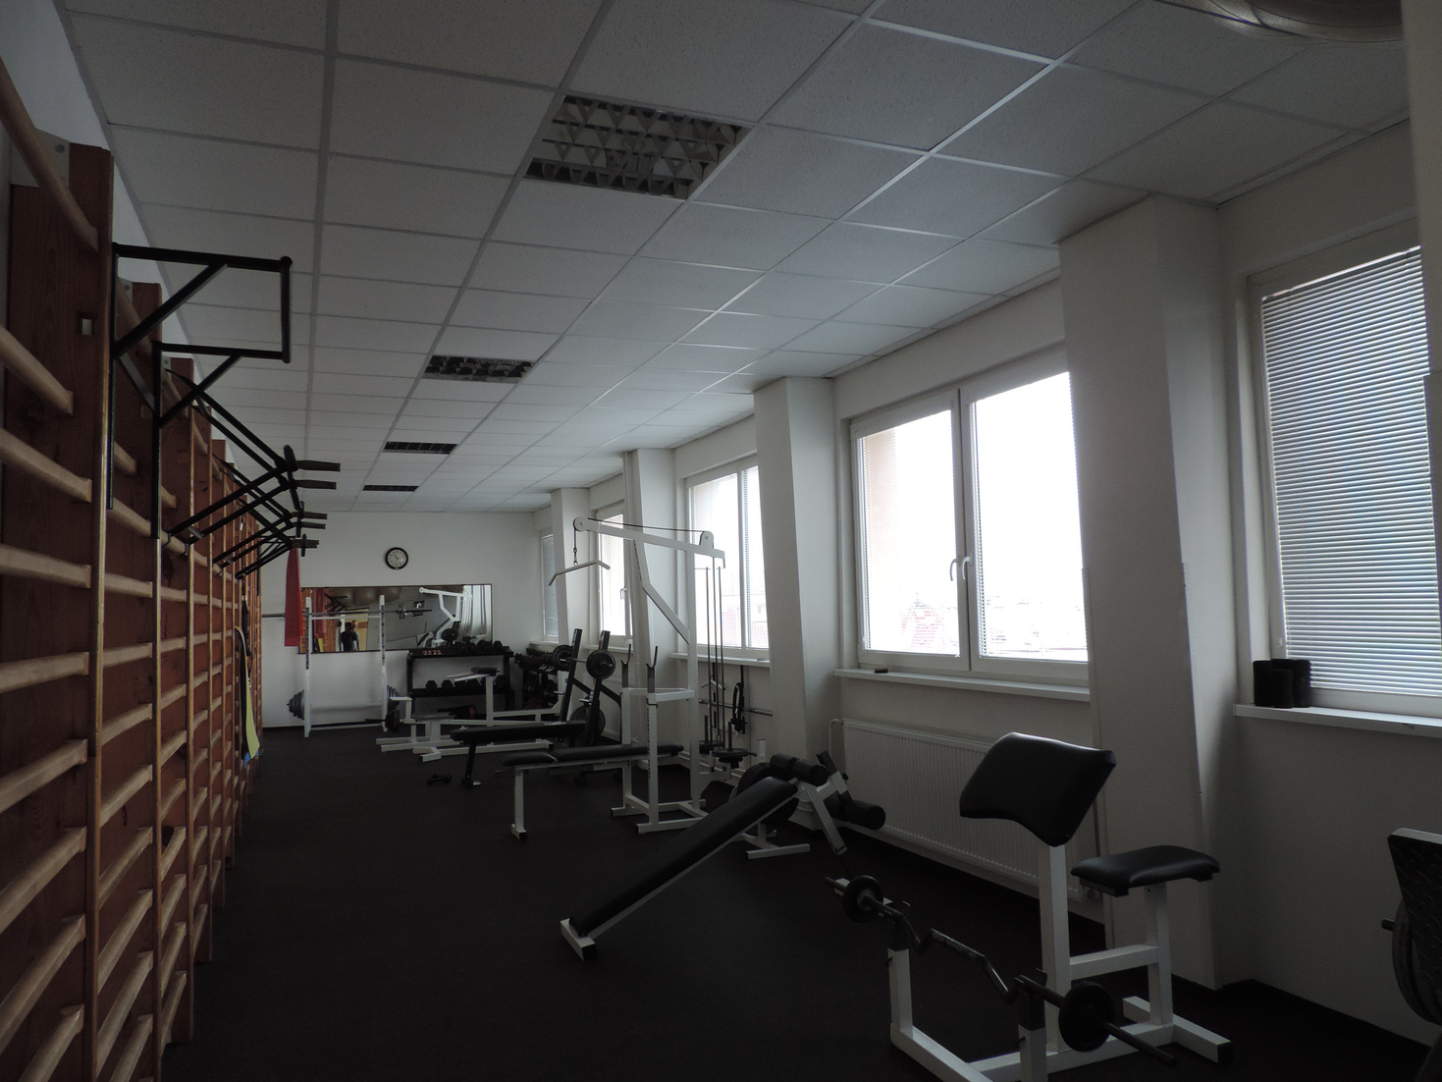
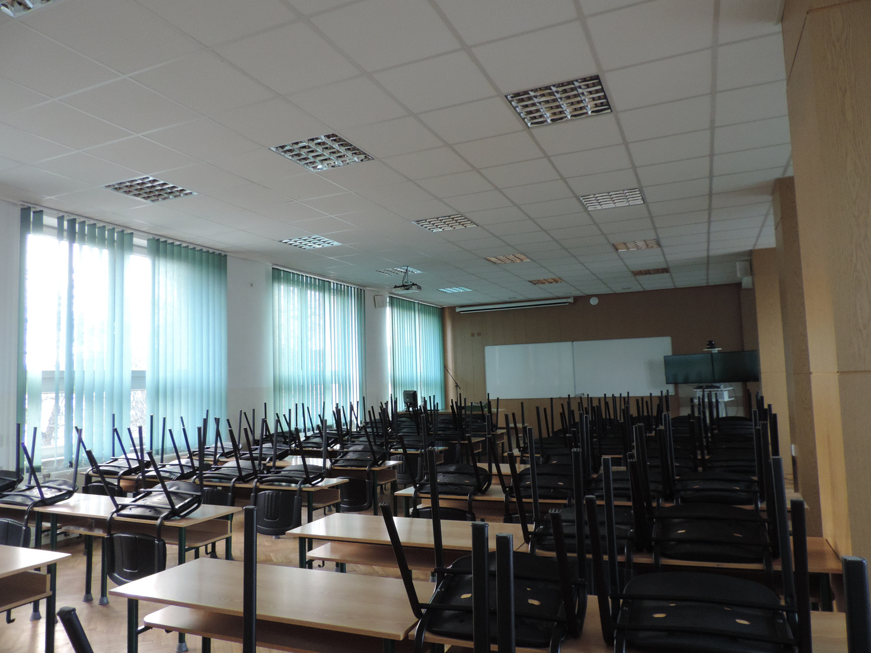
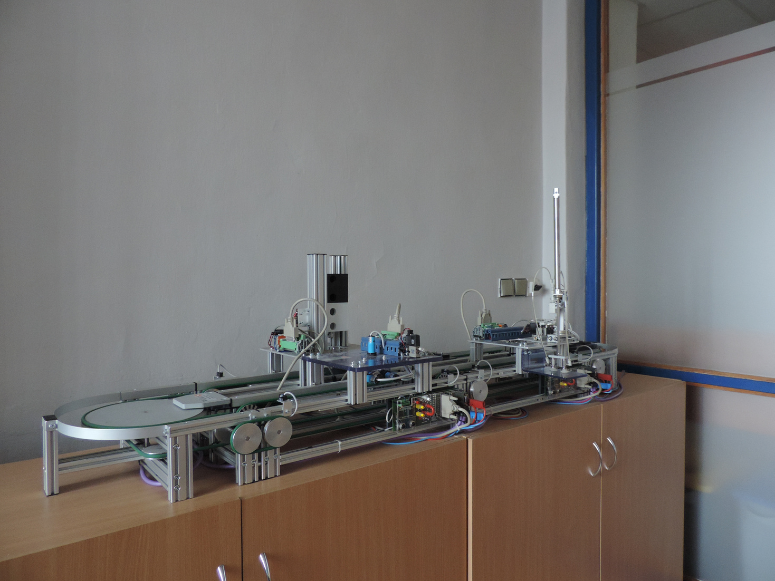
conference rooms
computer rooms
gym
student creations
leisure zone

