Slide 1
Learning, teaching &STUDyING
Pavel Svačina

Slide 2
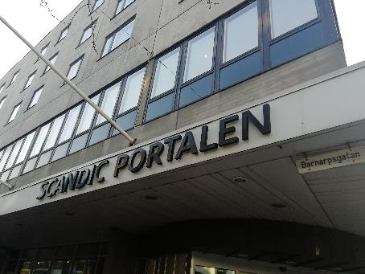
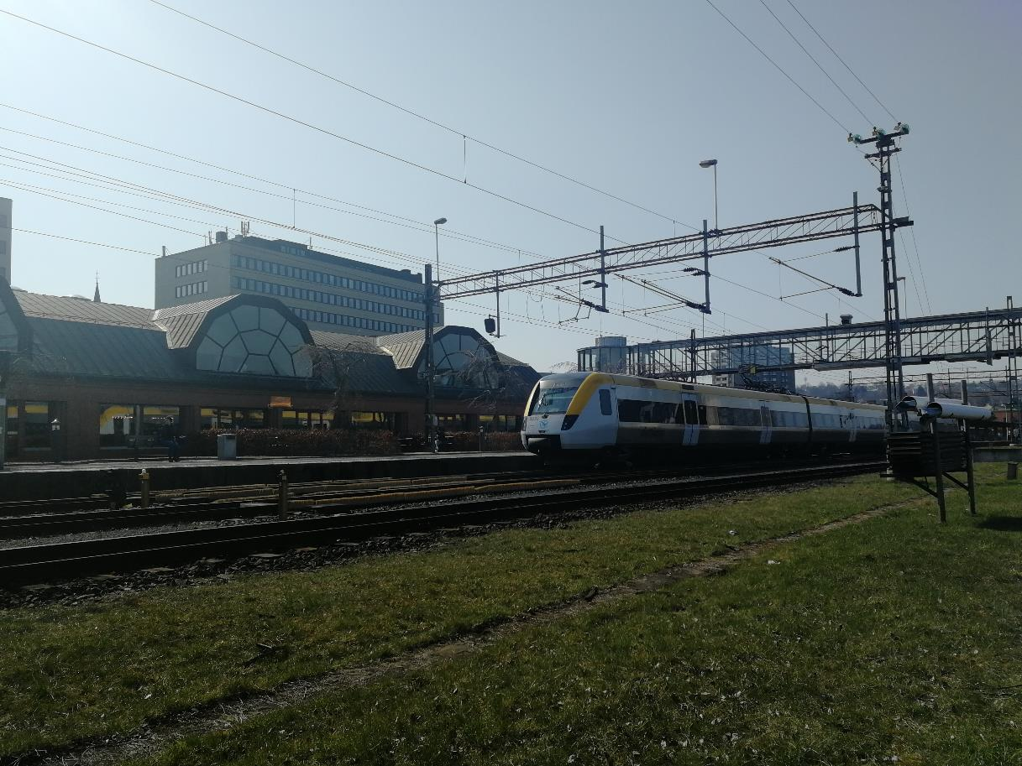
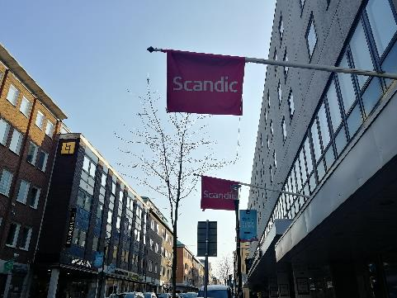
First views in Jönköping
railway station (below, but we arrrived by bus), then we were checked in the hotel Scandic Portalen nearby the station

Slide 3
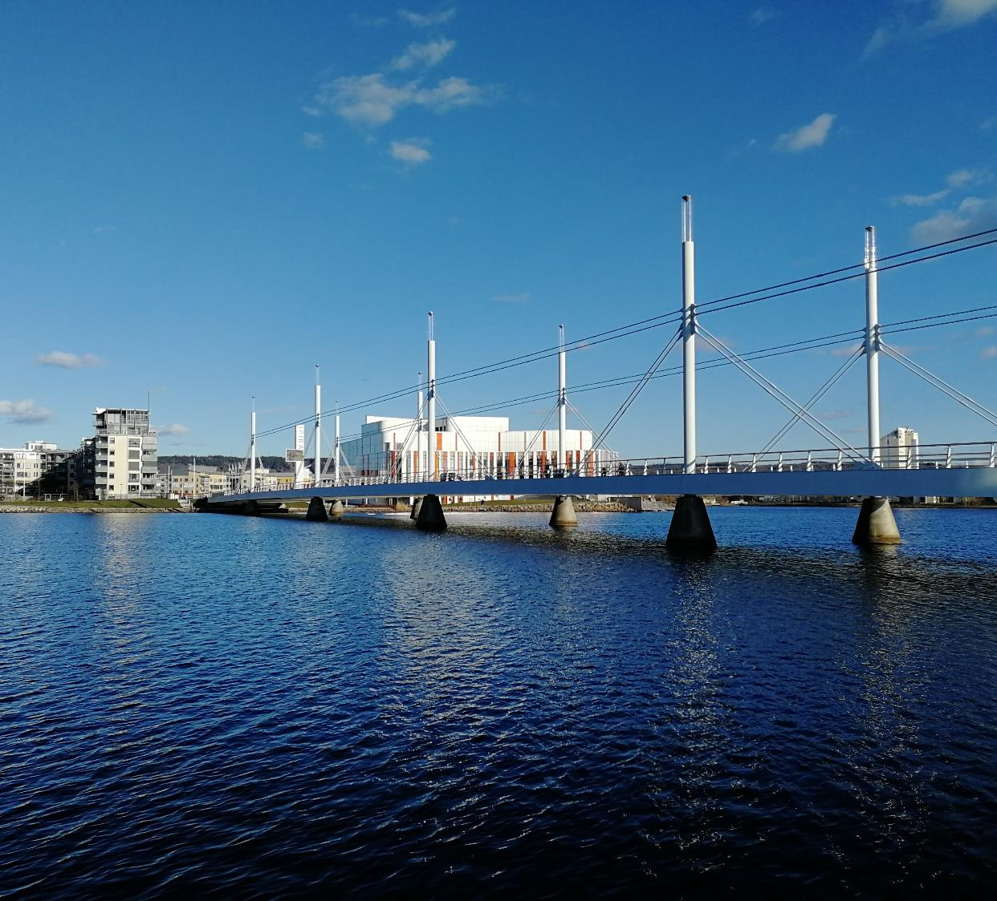
The Jönköping town
first mention in 1284, its population about 93 797 citizens, area 44.82 Km²
Jönköping was well-known by matches development in years 1845–1970
currently, the city is an important logistic centre in the south with companies such as: Elkjøp, IKEA, Electrolux and Husqvarna

Slide 4
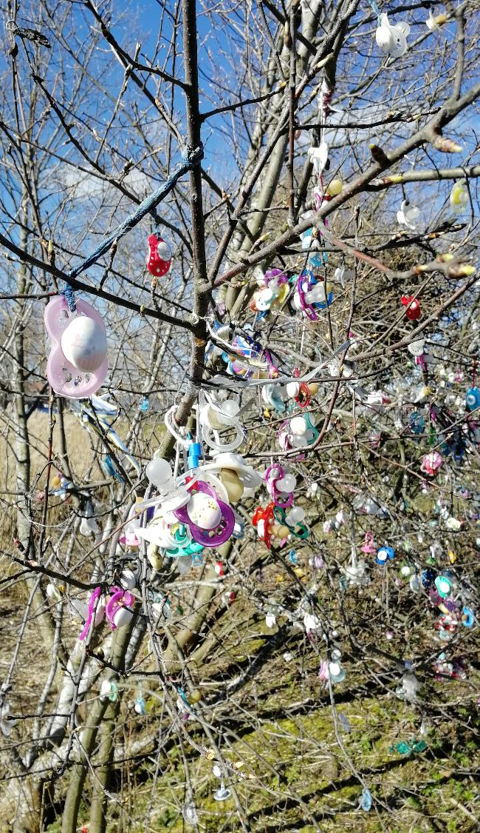
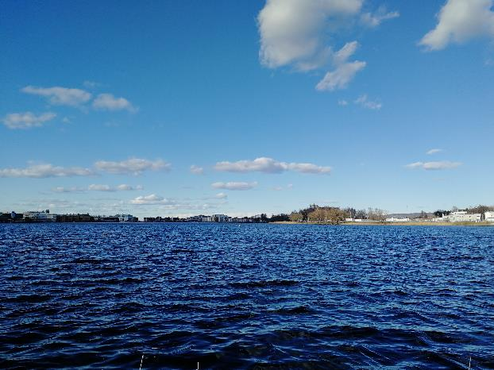
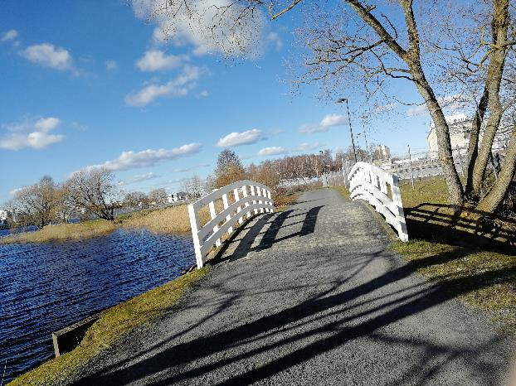
Lake Munksjön trip
on Sunday we had free time, so we decided to take a walk around lake (2 Km lenght) which is in the centre of the city
it takes about an hour by running, about 2 hours by walk
there is an interesting tree with baby dummies on it, kids playground and a lot of perfect views

Slide 5
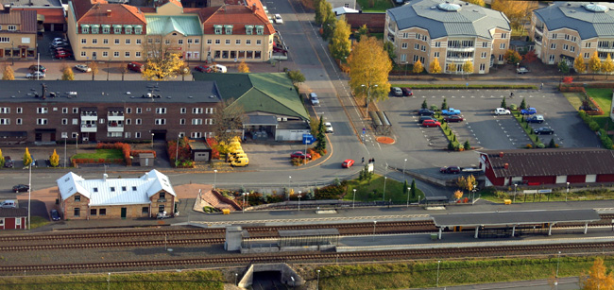
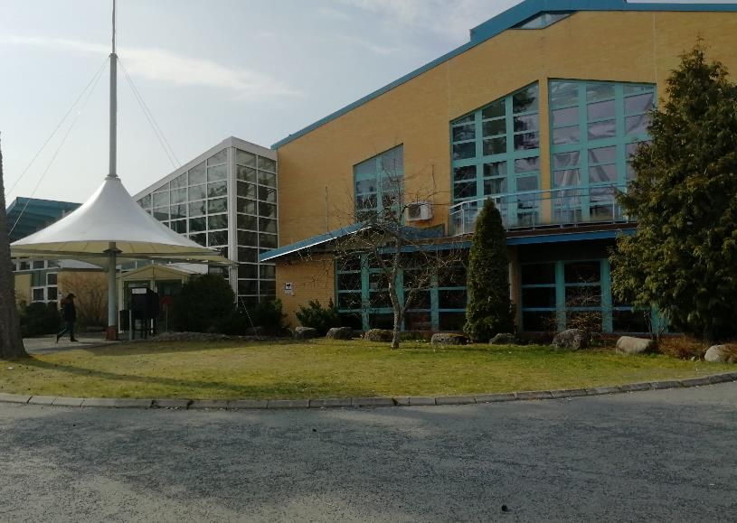
Vaggeryd
its population about 4,920 of citizens, area 4,80 Km², 30 Km (to) south from Jönköping
Vaggeryd was originally the seat for multiple furniture manufacturers, most of which have now shut down

Slide 7
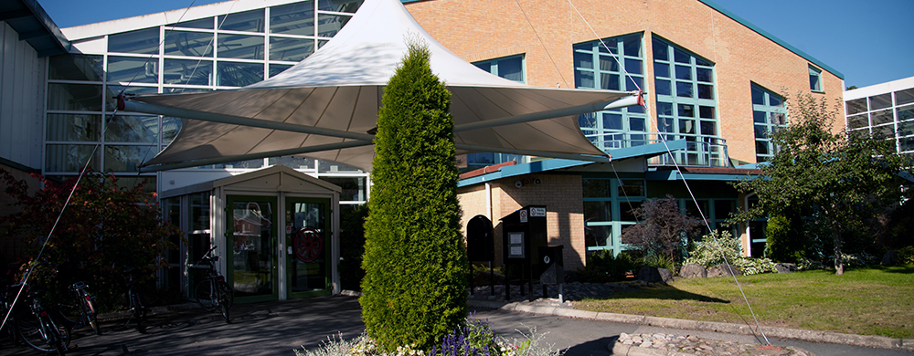
Secondary school Fenix
located in Vaggeryd, it is cultural and educational centre
Vaggeryd municipality had reached the goal of secondary school in 1996
the first completed building included also county library

Slide 8
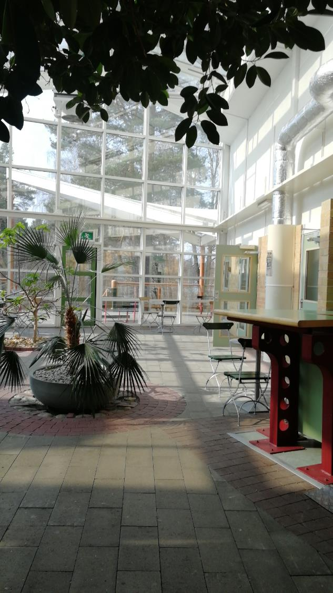
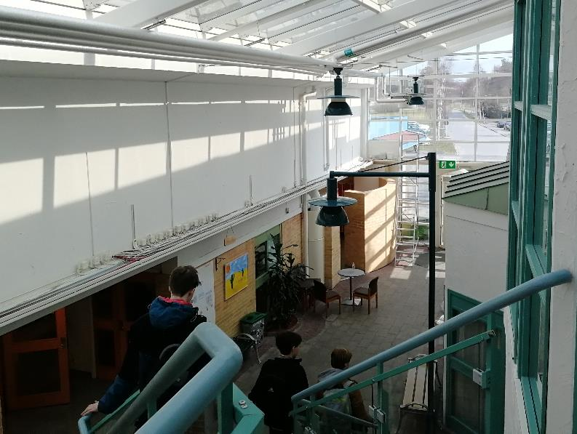
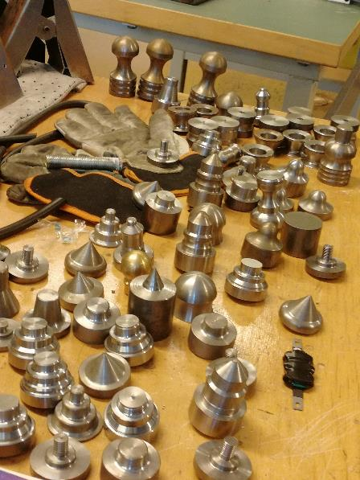
Fenix indoors
there are various school rooms in coverage such as: 3D printing, IT, CNC machines, Chemistry, library, bioscope and also technical MAKER SPACE,…
there is even school canteen and rest room with piano

Slide 9
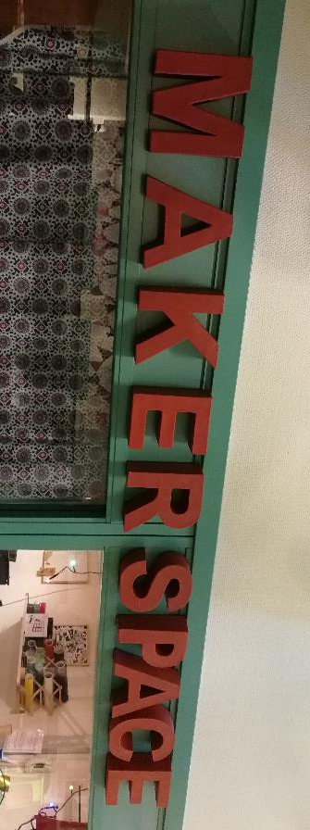
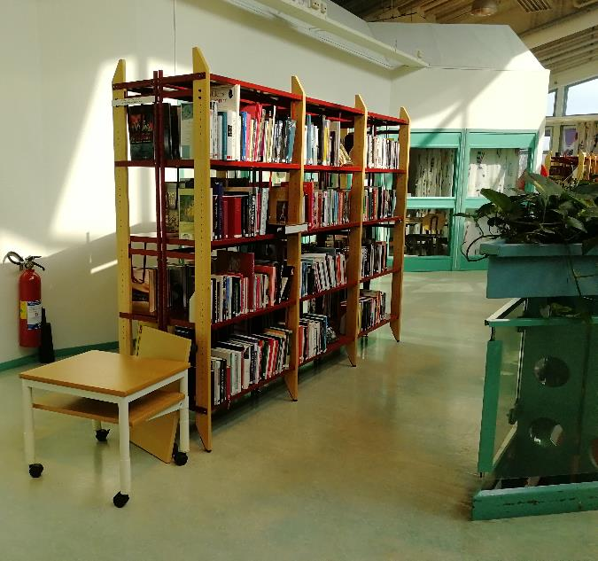
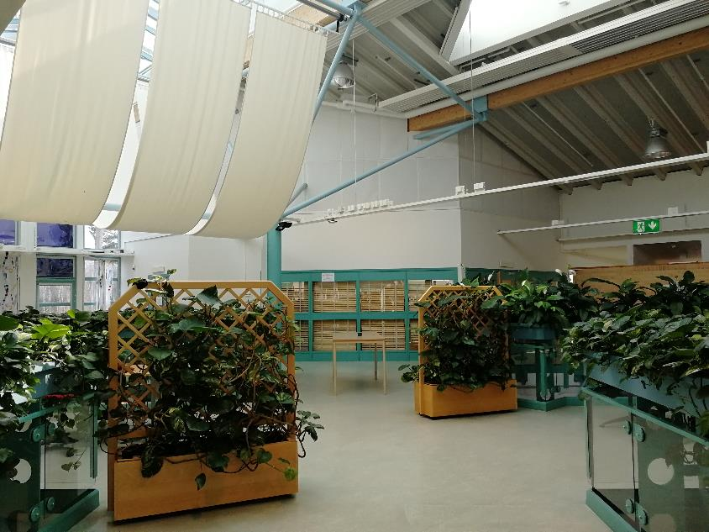
Fenix, remarkable school
the library with lots of shelfs in pleasant first floor at school surrounded by flowers
the MAKER SPACE is room where everybody can improve his skills in technic, 3D printer, Mindstorms lego or just create his own project

Slide 10
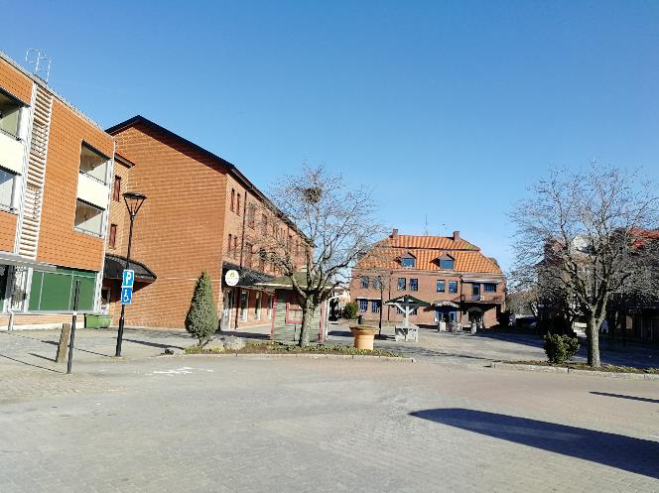
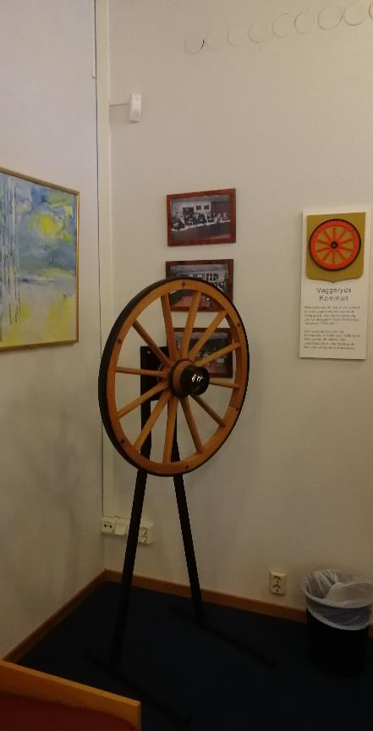
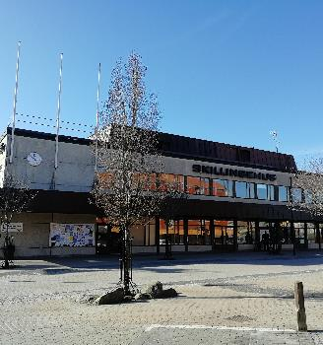
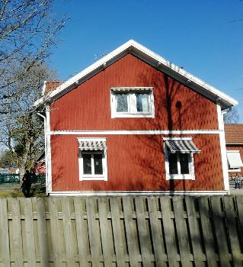
The city in Sweden
on Tuesday we went to Vaggeryd municipality where we had a presentation about Vaggeryd and Skillingrad and area in the surroundings
the city cares about nature and good relationships between people, but they also talked about their problems for example military noisy areas

Slide 11
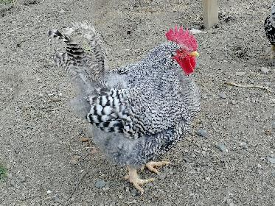
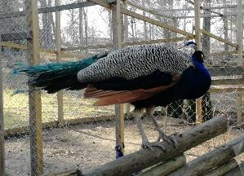
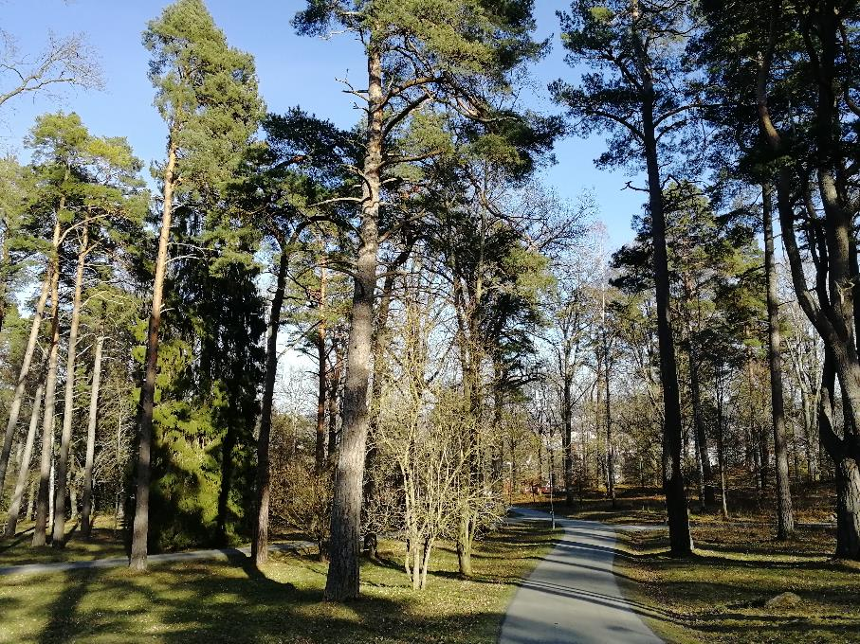
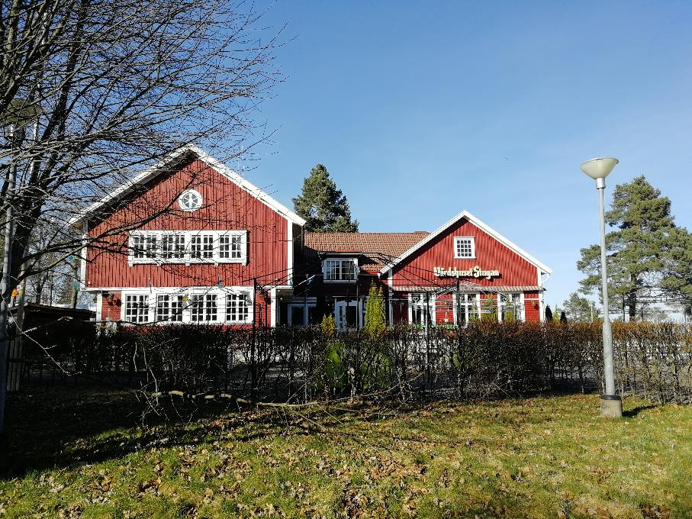
Vattenledningsparken
large park on the hill nearby the Vatten (lake)
there is an animal park (peacock, sheep, deer, llama)
interesting historical sights (The Educational Gravefield)

Slide 12
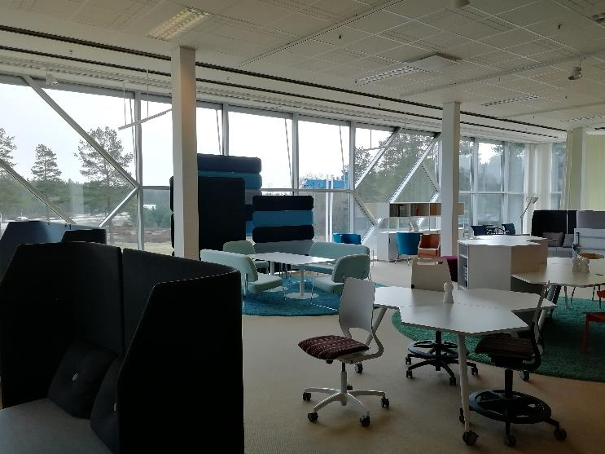
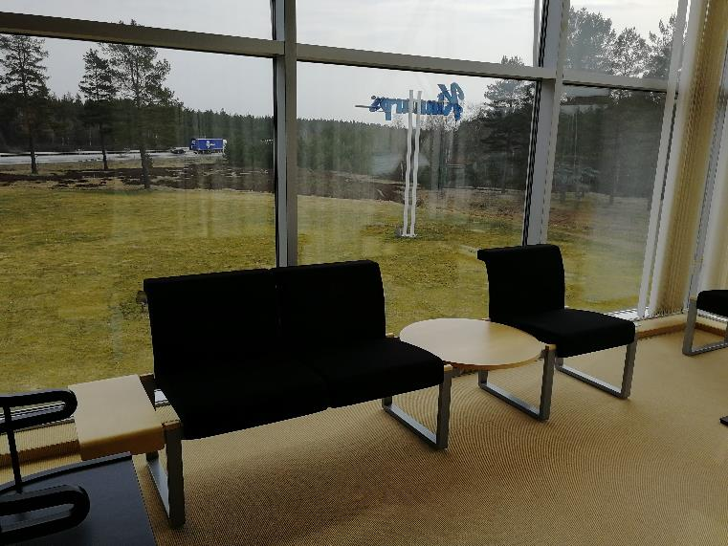
Excursion in Sweden
on Wednesday we visited Kinnarps furniture fabric
we had an excursion inside for 1,5 hour, then looked at a few of peaces of furniture
the products are made for individual customers all over the world
the production is mostly automated

Slide 13
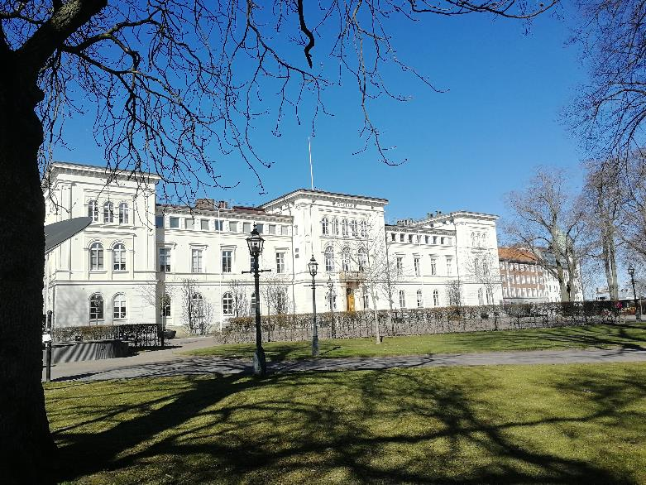
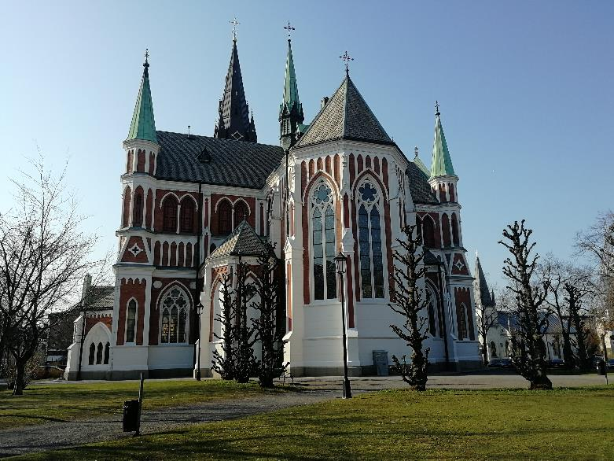
Jönköping in tourist´s eyes
three lakes in the centre: Vättern (length 129 Km), Munksjön (2 Km), Rocksjön (1 Km)
Jönköping University, Jönköping Secondary school, Town Hall, the bridge
Vättern (length 129 Km)

Slide 14
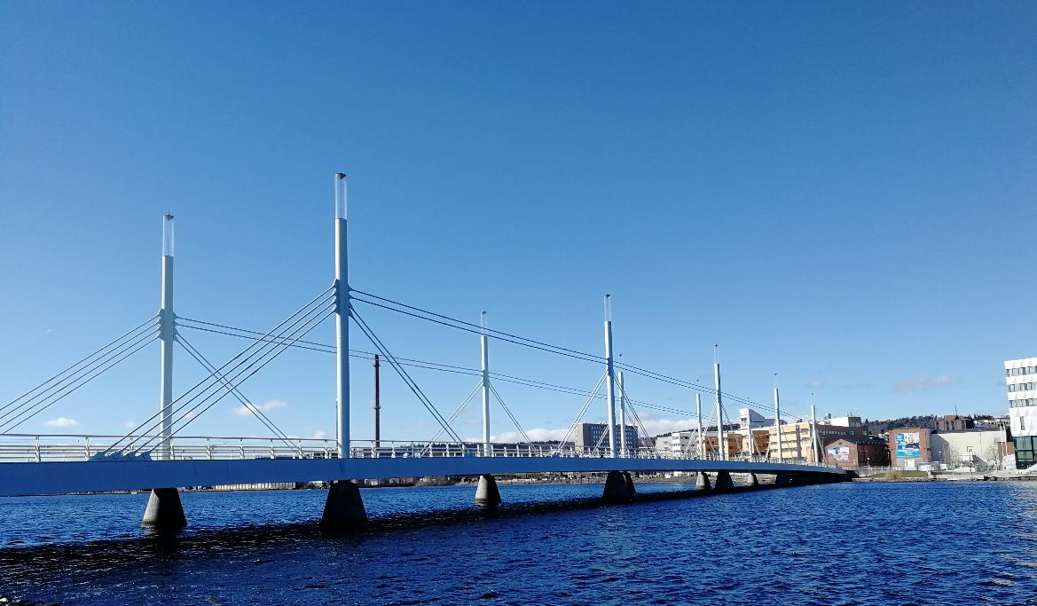
Town centre

Slide 15
Thank you for your attention The secondary school of electrical engineering ,,SPŠE PARDUBICE THE CZECH REPUBLIC´´
AND SPECIAL THANKS TO ALL WHO PARTICIPATED IN THIS PROJECT

